Slide 1
Project Planning & Scheduling
ISE 419

Slide 2
Project Scheduling
Project definition:
A complex and large scale one-of-a-kind product or service, made up by a number of component activities (jobs), that entails a considerable financial effort and must be time-phased, i.e. scheduled, according to specified precedence and resource requirements

Slide 3
Hierarchical planning
Strategic
Strategic resource planning
Rough-cut process planning
Rough-cut capacity planning
Tactical
Tactical/ operational
Engineering & process planning
Project scheduling
Detailed scheduling
Operational
Notes:
RCCP: Order acceptance
Detailed scheduling: van de individuele mensen

Slide 4
Overview
Critical Path
Method (CPM)
Program Evaluation
and Review Technique
(PERT)
No resource
Constraints
Project
Scheduling
Resource
Constraints
Heuristic Resource
Leveling
Integer Programming
Formulations

Slide 5
CPM and PERT
Network models can be used as an aid in the scheduling of large complex projects that consist of many activities.
CPM: If the duration of each activity is known with certainty, the Critical Path Method (CPM) can be used to determine the length of time required to complete a project.
PERT: If the duration of activities is not known with certainty, the Program Evaluation and Review Technique (PERT) can be used to estimate the probability that the project will be completed by a given deadline.

Slide 6
CPM and PERT are used in many applications including the following:
Scheduling construction projects such as office buildings, highways and swimming pools
Developing countdown and “hold” procedure for the launching of space crafts
Installing new computer systems
Designing and marketing new products
Completing corporate mergers
Building ships

Slide 7
Project Scheduling
Jobs subject to precedence constraints
Job on arc format (most common)
2
5
6
0
1
4
7
2
3
A
B
1
2
3
Activity A must be completed before activity B starts

Slide 8
While constructing an AOA type of project diagram one should use the following rules:
Node 1 represents the start of the project. An arc should lead from node 1 to represent each activity that has no predecessors.
A node (called the finish node) representing the completion of the project should be included in the network.
Number the nodes in the network so that the node representing the completion time of an activity always has a larger number than the node representing the beginning of an activity.
An activity should not be represented by more than one arc in the network
Two nodes can be connected by at most one arc.
To avoid violating rules 4 and 5, it can be sometimes necessary to utilize a dummy activity that takes 0 time.

Slide 9
Planning a Concert

Slide 10
Job on Arc Network
Not allowed: no two jobs can have the same starting and ending node!
Need to introduce a dummy job.
B
A
D
C
B
A
D
C

Slide 11
Changing a Tire
A
B
E
C
D

Slide 12
An example for CPM
Widgetco is about to introduce a new product. A list of activities and the precedence relationships are given in the table below. Draw a project diagram for this project.
Activity | Predecessors | Duration(days)
A:train workers | - | 6
B:purchase raw materials | - | 9
C:produce product 1 | A, B | 8
D:produce product 2 | A, B | 7
E:test product 2 | D | 10
F:assemble products 1&2 | C, E | 12

Slide 13
Project Diagram for Widgetco
C 8
F 12
3
5
6
A 6
D 7
1
Dummy
E 10
B 9
2
4
Node 1 = starting node
Node 6 = finish node

Slide 14
Project representation example
“job on node”-representation:
1
2
4
6
end
3
5
7
1
2
4
6
end
“job on arc”-representation:
3
7
5
Notes:
JON:
knoop = job
pijl = relatie
JOA:
knoop = begin of einde van een job
pijl = job
kenmerken JOA:
geen overbodige pijlen
geen cykels
lastig
niet unieke netwerken
(alleen interpretatie, niet afleiding??)
LINEAIRE vs. NETWERK precedentie relaties

Slide 15
Project representation example
“job on node”-representation:
1
2
4
6
3
5
end
“job on arc”-representation:
1
6
4
2
end
5
3

Slide 16
Critical Path Method
An analytical tool that provides a schedule that completes the project in minimum time subject to the precedence constraints. In addition, CPM provides:
Starting / ending times for each activity
Identification of the critical activities (i.e., the ones whose delay necessarily delay the project).
Identification of the non-critical activities, and the amount of slack time available when scheduling these activities.
Think of unlimited machines in parallel
… and n jobs with precedence constraints
Objective to minimize makespan

Slide 17
Critical Path Method (CPM)
Critical job: job without slack
Critical path = chain of critical jobs
Notes:
Slack = speling

Slide 18
Critical Path Method (CPM)
Critical path method initialization:
determine earliest starting time for all jobs
determine latest completion time for all jobs
determine which jobs have no slack
2 CPM solution methods:
Forward procedure
Backward procedure

Slide 19
Critical Path Method
Forward procedure:
Starting at time zero, calculate the earliest each job can be started
The completion time of the last job is the makespan
Backward procedure
Starting at time equal to the makespan, calculate the latest each job can be started so that this makespan is realized

Slide 20
Forward Procedure
Step 1:
Set at time t = 0 for all jobs j with no predecessors,
S_{j}’=0 and set C_{j}’ = p_{j}.
Step 2:
Compute for each job j
C_{j}’ = S_{j}’ + p_{j}.
Step 3:
The optimal makespan is
STOP
k=1
k=2
j=4

Slide 21
Backward Procedure
Step 1:
Set at time t = C_{max} for all jobs j with no successors,
C_{j}’’= C_{max} and set S_{j}’’ = C_{max} - p_{j}.
Step 2:
Compute for each job j
S_{j}’’ = C_{j}’’ - p_{j}.
Step 3:
Verify that
STOP
k=6
j=3
k=5

Slide 22
Comments
The forward procedure gives the earliest possible starting time for each job
The backwards procedures gives the latest possible starting time for each job
If these are equal the job is a critical job.
If these are different the job is a slack job, and the difference is the float.
A critical path is a chain of jobs starting at time 0 and ending at C_{max}.

Slide 23
Example
2
4
7
10
1
6
9
12
14
3
11
13
5
8

Slide 24
Forward Procedure
5+6=11
11+12=23
23+10=33
2
4
7
33+9=42
5
10
1
14+12=26
26+10=36
43+8=51
51+5=56
6
9
12
14
3
11
13
5+9=14
43+7=50
36+7=43
5
8
14+7=21
26+6=32

Slide 25
Backwards Procedure
24-12=12
34-10=24
43-9=34
S₂’’= 12-6 = 6
2
4
7
51-8=43
14-9=5
10
1
36-10=26
43-7=36
56-5=51
56
6
9
12
14
S₃’’= 14-9 = 5
3
11
13
26-12=14
56-5=51
51-8=43
5
8
36-10=26
43-7=36

Slide 26
Critical Path
2
4
7
10
1
6
9
12
14
3
11
13
5
8

Slide 27
Another Example
4
9
8
8
1
2
6
7
3
3
6
6
9
3
4
5
12
8
Notes:
Pinedo's book page 66

Slide 28
Forward and Backward Passes
4
9
8
8
1
2
6
7
3
3
6
9
6
3
4
5
12
8

Slide 29
Critical Path
4
9
8
8
1
2
6
7
3
3
6
6
9
3
4
5
12
8

Slide 30
PERT: Project Evaluation and Review Technique
PERT is a generalization of CPM to allow for uncertain activity times. For each activity the user must specify:
a = minimum completion time
b = maximum completion time
m = most likely completion time
The method assumes each activity time follows a beta distribution, which can be fit precisely with specification of a, b, and m.
The following figure provides an example with a= 5, b=20 and m=17).

Slide 31
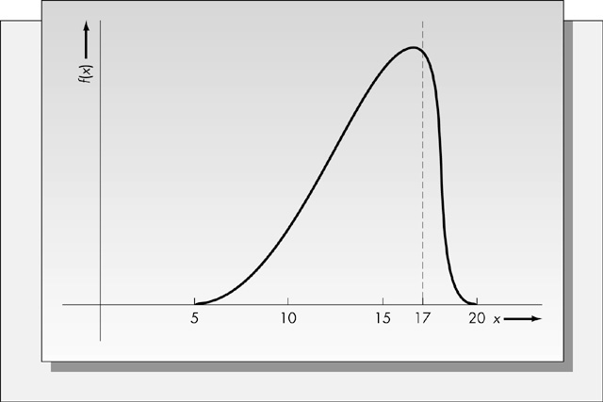
Probability Density of Activity Time

Slide 32
PERT
The mean and standard deviation of activity times are estimated from the following formulas (based on the beta distribution)
In PERT one assumes that the path the with longest expected completion time is the true critical path (this is only an approximation, since true critical path is a random variable).

Slide 33
PERT
PERT requires the assumption that the durations of all activities are independent. Thus,
Finally, one invokes the Central Limit Theorem to conclude that the total project completion time is a random variable whose distribution is approximately normal.
: expected duration of activities on any path
: variance of duration of activities on any path

Slide 34
Example: a, b and m for activities in Widgetco
C 8
F 12
3
5
6
A 6
D 7
1
Dummy
E 10
B 9
2
4
Activity | a | b | m
A | 2 | 10 | 6
B | 5 | 13 | 9
C | 3 | 13 | 8
D | 1 | 13 | 7
E | 8 | 12 | 10
F | 9 | 15 | 12

Slide 35
According to the table on the previous slide:

Slide 36
Of course, the fact that arc (2,3) is a dummy arc yields
E(T₂₃)=varT₂₃=0
The critical path is 1-2-3-4-5-6.
Thus,
E(CP)=9+0+7+10+12=38
varCP=1.78+0+4+0.44+1=7.22
Then the standard deviation for CP is (7.22)^{1/2}=2.69
PERT implies that there is a 13% chance that the project will be completed within 35 days.

Slide 37
Discussion
Potential problems with PERT:
Always underestimates project duration
other paths may delay the project
Non-critical paths ignored
critical path probability
critical activity probability
Activities are not always independent
same raw material, weather conditions, etc.
Estimates may be inaccurate

Slide 38
Improved PERT parameter estimates
Reference: H.-S. Lau and H.-L. Lau, An Improved PERT-type Formula for Standard Deviation. IIE Transactions, 30, 1998, 273-275.
Improvement over “extended Pearson-Tukey” formula.
Pearson-Tukey mean:
Original variance estimate assumed a Beta dist
Special case of Pearson family of distributions
“many, if not most, empirical distributions fall outside Beta area…”

Slide 39
Improved PERT parameter estimates
Form of improved variance estimate
Regression used to get parameter estimates
5000 randomly generated Pearson distributions sampled within “most applicable” range
Alphas considered: .01, .025, .05, .1, .25
Positive skew:
Negative skew:
best

Slide 40
Time Costing Methods
Suppose that projects can be expedited by reducing the time required for critical activities.
Doing so results in an increase in some costs and a decrease in others.
The goal is to determine the optimal number of days to schedule the project to minimize total cost.

Slide 41
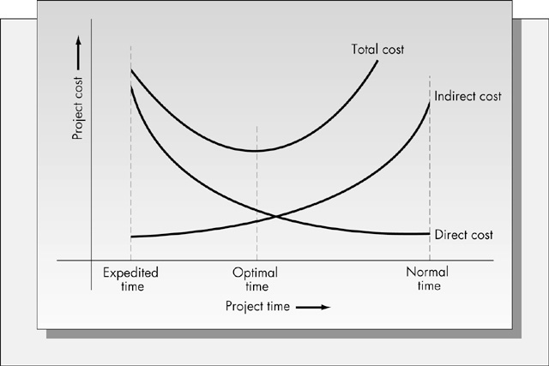
Optimal Project Completion Time
Since direct costs decline with the project time and indirect costs increase with the project time, the total cost curve is a convex function whose minimum corresponds to the optimal solution.

Slide 42
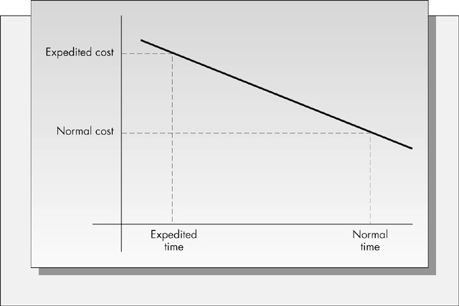
The CPM Cost-Time Linear Model
Assume that there is a linear time/cost relationship for each activity.

Slide 43
Linear Costs
Money
Marginal
cost
Processing
time

Slide 44
Problem
Spend money to reduce processing times so as to minimize:
“Overhead” cost
Cost per activity

Slide 45
Time/costs trade-off heuristic
Definitions:
source and sink in precedence graph
critical path: longest path from source to sink
G_{cp} = sub-graph of critical path(s)
cut set: set of nodes in sub-graph G_{cp} whose removal results in disconnecting the source from the sink in the precedence graph
minimal cut set: if putting back 1 node in the graph connects the source to the sink

Slide 46
Sources, Sinks, and Cuts
Cut set
Sink node
Source (dummy) node
Minimal cut set

Slide 47
Time/costs trade-off heuristic
STEP 1: Set
Determine G_{cp} (Critical Path Method) .
STEP 2: Determine all minimum cut sets mcs in G_{cp}.
Consider only those mcs with all processing times
If there is no such set: STOP
STEP 3: For each mcs compute the costs of
reducing all p_{j} in mcs by 1 time unit.
Let mcs* be the mcs with the lowest costs
If the lowest costs are <c₀ ⇒ apply the
changes
STEP 4: Revise G_{cp} by reducing proc. times in the mcs by 1 and finding new set of critical paths. Go to STEP 2

Slide 48
Example

Slide 49
Time/costs trade-off heuristic example
processing time
6
12
10
9
2
4
7
10
8
5
12
5
12
10
S
1
14
T
6
9
9
7
7
3
11
13
7
6
5
8
Notes:
Slightly different solution path (correct!!)

Slide 50
Critical Path Subgraph (G_{cp})
C₁=7
C₆=3
C₉=4
C₁₂=2
C₁₄=8
1
6
9
12
14
3
11
C₃=4
C₁₁=2
Minimum cut
set with lowest cost
Cut sets: {1},{3},{6},{9},
{11},{12},{14}.

Slide 51
Time/costs trade-off heuristic example
6
12
10
9
2
4
7
10
7
5
12
5
12
10
S
1
14
T
6
9
9
7
7
3
11
13
7
6
5
8
Notes:
Here I alter the solution path of the book: the book alters job 6 (costs 3), and I alter job 11

Slide 52
Critical Path Subgraph (G_{cp})
C₁=7
C₆=3
C₉=4
C₁₂=2
C₁₄=8
1
6
9
12
14
3
11
13
C₃=4
C₁₁=2
C₁₃=4
Cut sets: {1},{3},{6},{9},
{11},{12,13},{14}.
Minimum cut
set with lowest cost

Slide 53
Time/costs trade-off heuristic example
6
12
10
9
2
4
7
10
7
5
12
5
12
10
S
1
14
T
6
9
9
6
7
3
11
13
7
6
5
8

Slide 54
Critical Path Subgraph (G_{cp})
C₂=2 C₄=3 C₇=4
2
4
7
C₁=7
C₁₀=5
10
C₁₂=2
C₆=3
C₉=4
C₁₄=8
1
6
9
12
14
3
11
13
C₃=4
C₁₁=2
C₁₃=4

Slide 55
Time/costs trade-off heuristic example
job 2 hits
minimum
5^{min}
12
10
9
2
4
7
10
7
5
12
5
12
10
S
1
14
T
6
9
9
5
7
3
11
13
7
6
5
8

Slide 56
Time/costs trade-off heuristic example
5^{min}
11
10
9
2
4
7
10
7
5
12
5
12
10
S
1
14
T
6
9
9
4^{min}
7
3
11
13
7
6
5
8
Notes:
Makespan can still be reduced with the same cost: for example {12,13}
OPTIMALITY CONDITION: when no P(j) can be increased without enlarging the makespan

Slide 57
Time/costs trade-off heuristic example
5^{min}
11
10
9
2
4
7
10
5^{min}
5
12
5
10
10
S
1
14
T
6
9
9
4^{min}
7
3
11
13
7
6
5
8

Slide 58
Time/costs trade-off LP model
Decision variables:
x_{j} = earliest starting time of job j
p_{j} = processing time of job j
Total cost:
Constraints:
precedence relations:
max/min processing times:
C_{max} determination:
Notes:
Cmax = auxiliary variable

Slide 59
Time/costs trade-off: nonlinear costs
Discrete time-framework:
decreasing convex cost-function
non-decreasing overhead cost-function c₀(t)
use the same heuristic as for the linear costs
Continuous time-framework:
non-linear model with the same constraints as the LP-model, but with the objective:

